Slide 1


Sadique Ahmad
04 August 2024

Slide 2

Outline
Executive Summary
Introduction
Methodology
Results
Conclusion
Appendix

Slide 3
Executive Summary
Summary of methodologies
Data Collection through API
Data Collection with Web Scraping
Data Wrangling
Exploratory Data Analysis with SQL
Exploratory Data Analysis with Data Visualization
Interactive Visual Analytics with Folium
Machine Learning Prediction
Summary of all results
Exploratory Data Analysis result
Interactive analytics in screenshots
Predictive Analytics result

Slide 4
Introduction
Project background and context
Space X advertises Falcon 9 rocket launches on its website with a cost of 62 million dollars; other providers cost upward of 165 million dollars each, much of the savings is because Space X can reuse the first stage. Therefore, if we can determine if the first stage will land, we can determine the cost of a launch. This information can be used if an alternate company wants to bid against space X for a rocket launch. This goal of the project is to create a machine learning pipeline to predict if the first stage will land successfully.
Problems you want to find answers
What factors determine if the rocket will land successfully?
The interaction amongst various features that determine the success rate of a successful landing.
What operating conditions needs to be in place to ensure a successful landing program.

Slide 5

Section 1

Slide 6
Methodology
Executive Summary
Data collection methodology:
Data was collected using SpaceX API and web scraping from Wikipedia.
Perform data wrangling
One-hot encoding was applied to categorical features
Perform exploratory data analysis (EDA) using visualization and SQL
Perform interactive visual analytics using Folium and Plotly Dash
Perform predictive analysis using classification models
How to build, tune, evaluate classification models

Slide 7
Data Collection
The data was collected using various methods
Data collection was done using get request to the SpaceX API.
Next, we decoded the response content as a Json using .json() function call and turn it into a pandas dataframe using .json_normalize().
We then cleaned the data, checked for missing values and fill in missing values where necessary.
In addition, we performed web scraping from Wikipedia for Falcon 9 launch records with BeautifulSoup.
The objective was to extract the launch records as HTML table, parse the table and convert it to a pandas dataframe for future analysis.

Slide 8
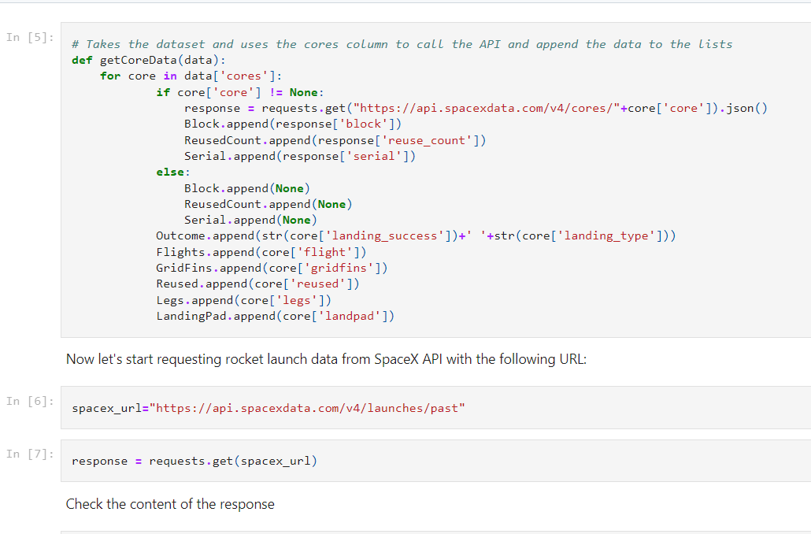
Data Collection – SpaceX API
Present your data collection with SpaceX REST calls using key phrases and flowcharts
Add the GitHub URL of the completed SpaceX API calls notebook (https://github.com/sadiqkhan/testrepo/blob/main/jupyter-labs-spacex-data-collection-api.ipynb), as an external reference and peer-review purpose

Slide 9
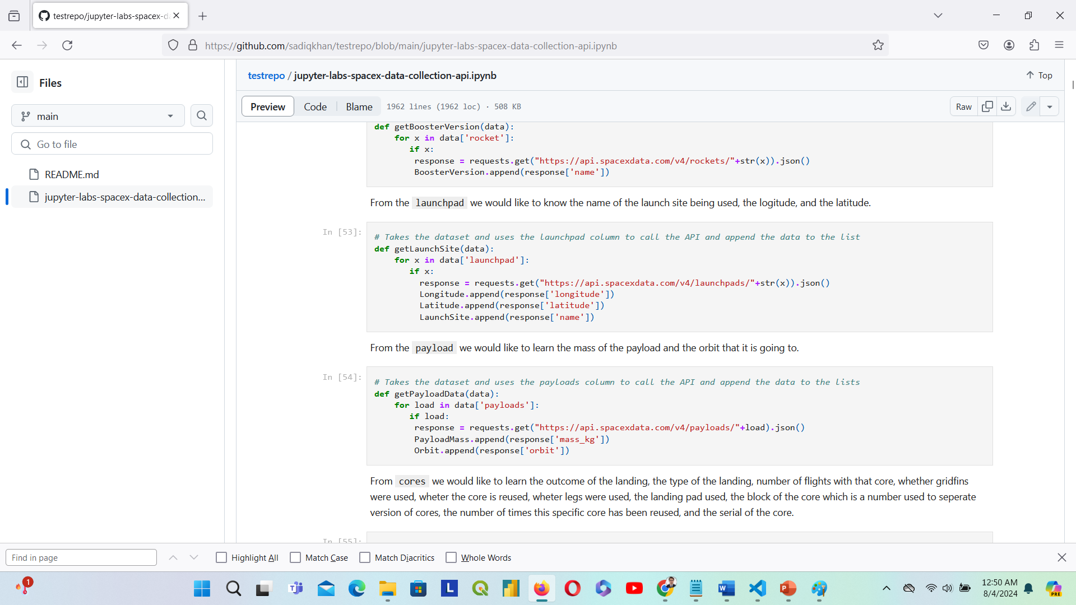
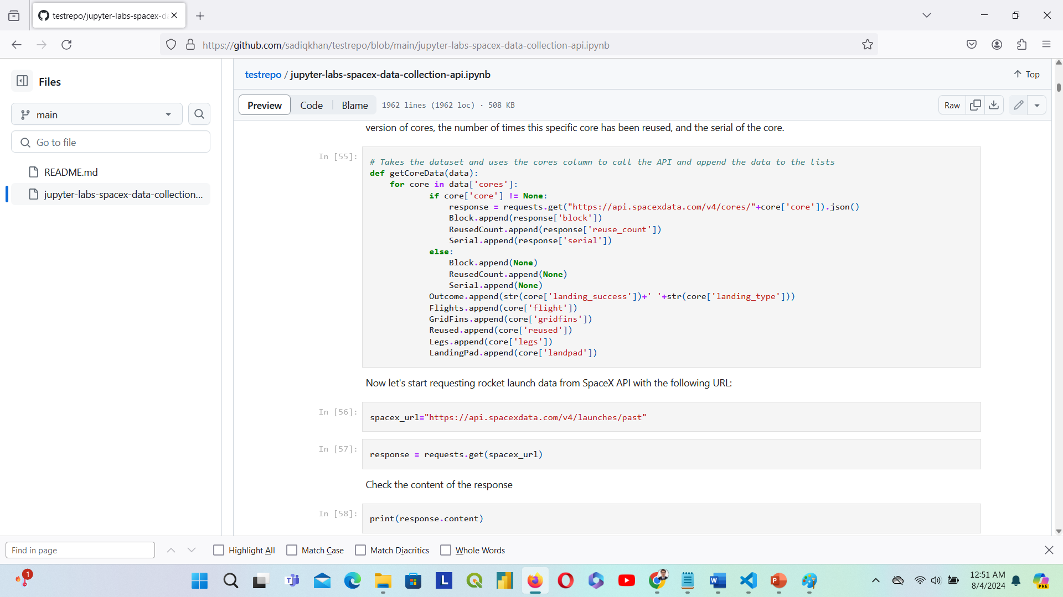

Slide 10
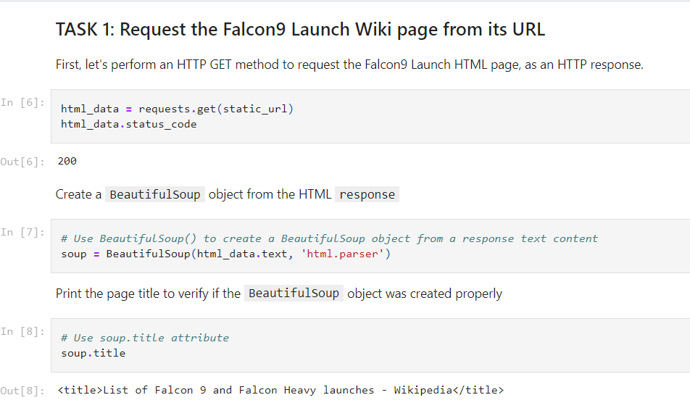
Data Collection - Scraping
Present your web scraping process using key phrases and flowcharts
Add the GitHub URL of the completed web scraping notebook, as an external reference and peer-review purpose. https://github.com/sadiqkhan/testrepo/blob/main/jupyter-labs-webscraping.ipynb

Slide 11

Data Wrangling
We performed exploratory data analysis and determined the training labels.
We calculated the number of launches at each site, and the number and occurrence of each orbits
We created landing outcome label from outcome column and exported the results to csv.
The link to the notebook is https://github.com/sadiqkhan/testrepo/blob/main/labs-jupyter-spacex-Data%20wrangling.ipynb.

Slide 12
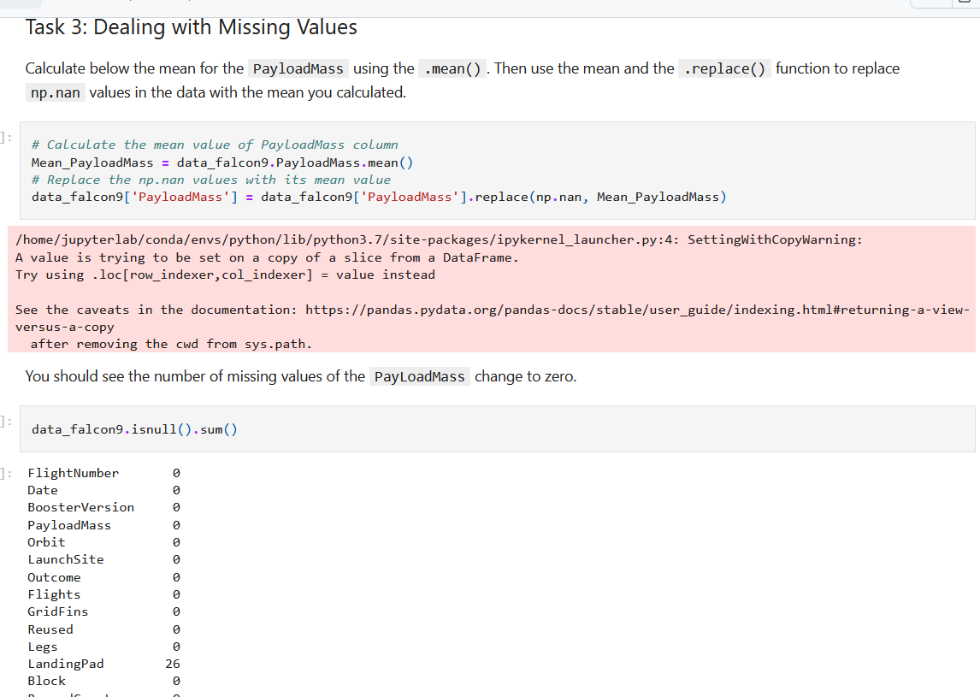
Data Wrangling
https://github.com/sadiqkhan/testrepo/blob/main/jupyter-labs-spacex-data-collection-api.ipynb

Slide 13
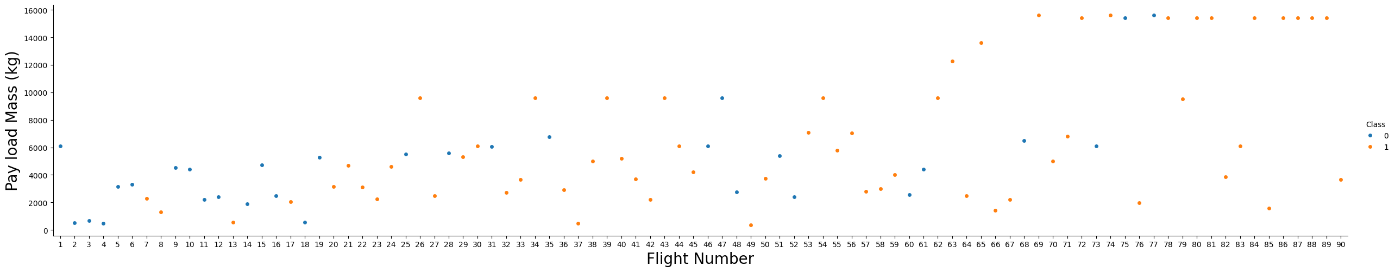
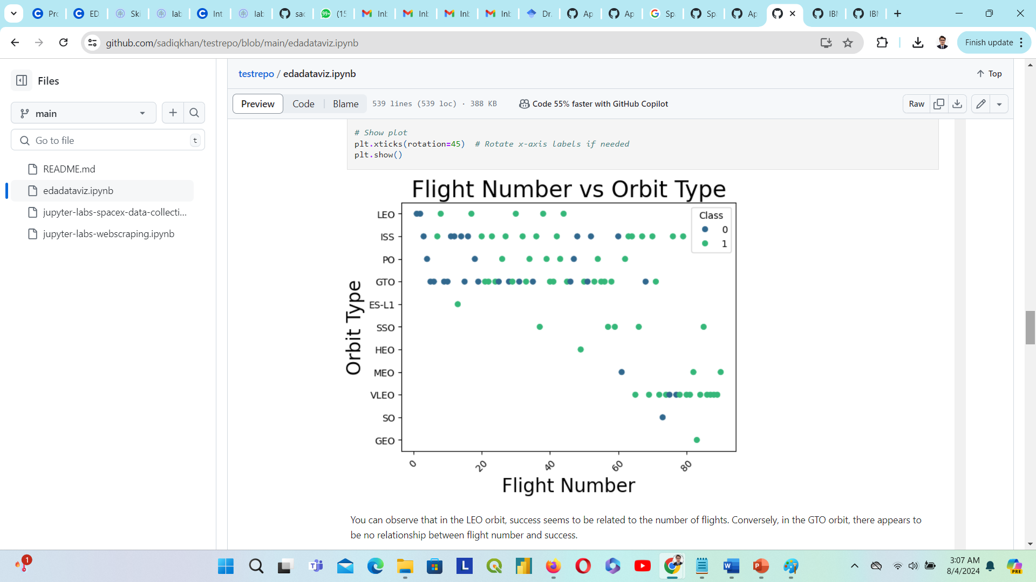
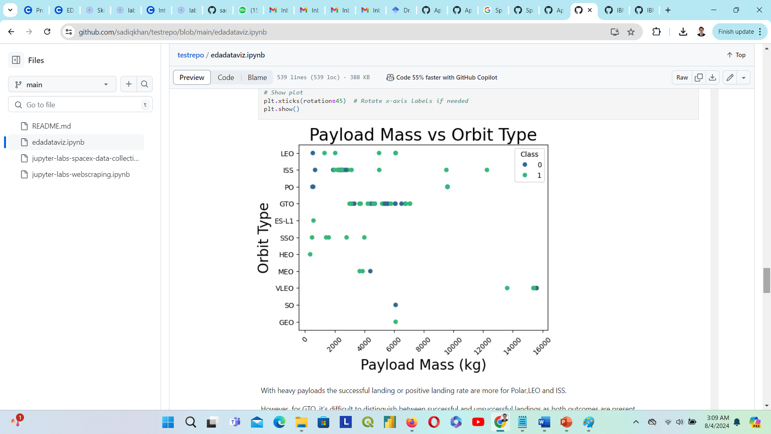
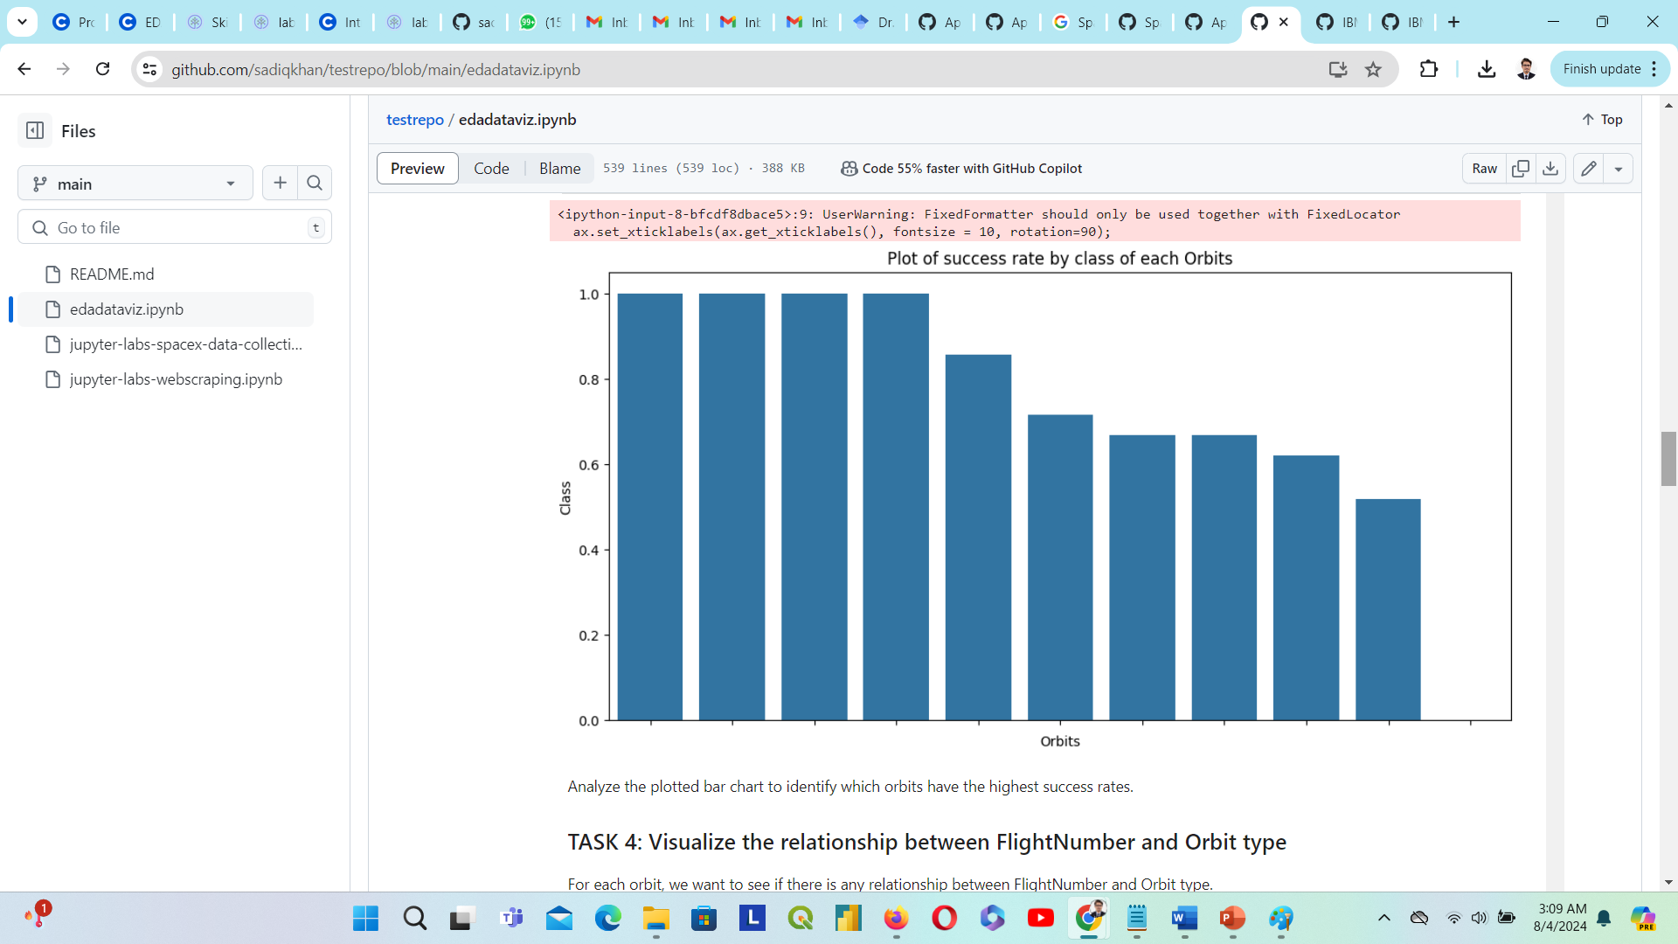
EDA with Data Visualization
I explored the data by visualizing the relationship between flight number and launch Site, payload and launch site, the success rate of each orbit type, flight number and orbit type, and the launch success yearly trend.
During EDA and data visualization, the following charts are achieved. Here is the link for complete code and results. https://github.com/sadiqkhan/testrepo/blob/main/edadataviz.ipynb

Slide 14
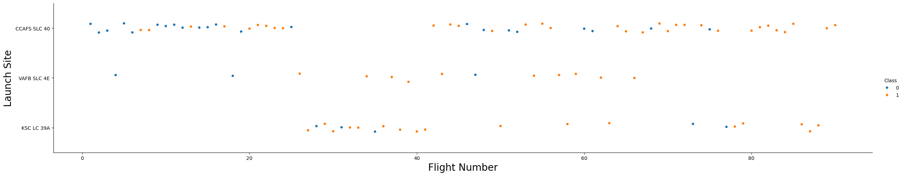
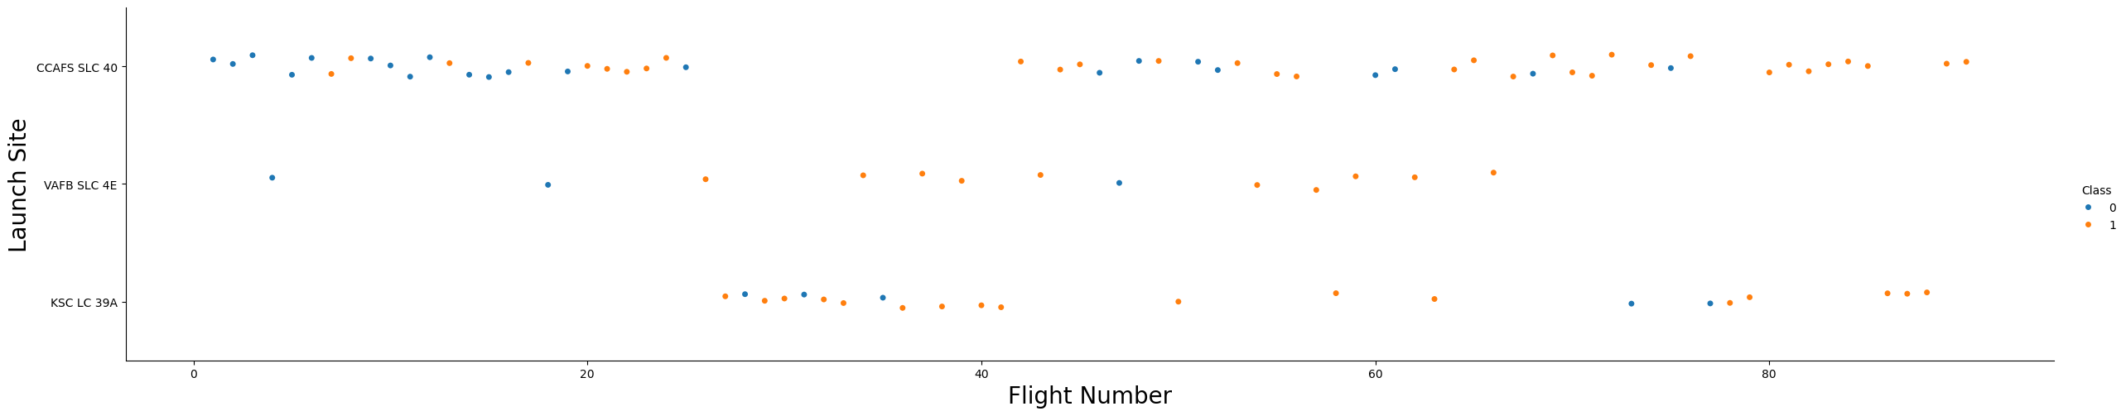
We explored the data by visualizing the relationship between flight number and launch Site, payload, and launch site, the success rate of each orbit type, flight number, and orbit type, and the launch success yearly trend etc.

Slide 15
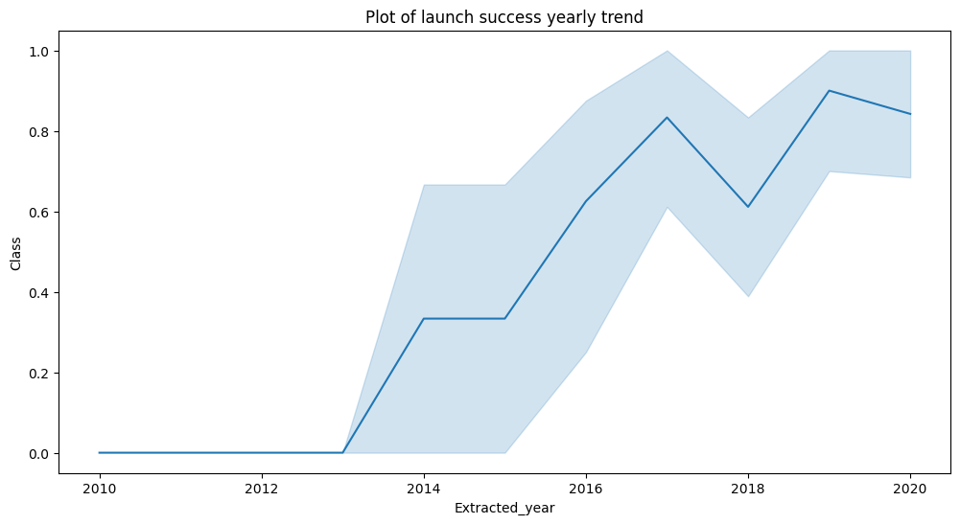

Slide 16
EDA with SQL
Using bullet point format, summarize the SQL queries you performed
%sql SELECT DISTINCT "Launch_Site" FROM SPACEXTABLE;
%sql SELECT * FROM SPACEXTABLE WHERE "Launch_Site" LIKE 'CCA%' LIMIT 5;
%sql SELECT SUM("Payload_Mass") AS Total_Payload_Mass FROM SPACEXTABLE WHERE "Launch_Provider" = 'NASA (CRS)’;
%sql SELECT "Booster_Version" FROM SPACEXTABLE WHERE "Payload_Mass" = (SELECT MAX("Payload_Mass") FROM SPACEXTABLE);
%sql SELECT "Landing_Outcome", COUNT(*) AS Total_Count FROM SPACEXTABLE GROUP BY "Landing_Outcome";
%sql SELECT DISTINCT "Booster_Name" FROM SPACEXTABLE WHERE "Landing_Outcome" = 'Success' AND "Landing_Pad" = 'Drone Ship' AND "Payload_Mass" > 4000 AND "Payload_Mass" < 6000;
%sql SELECT MIN("Date") AS First_Successful_Landing_Date FROM SPACEXTABLE WHERE "Landing_Outcome" = 'Success’;
%sql SELECT AVG("Payload_Mass") AS Average_Payload_Mass FROM SPACEXTABLE WHERE "Booster_Version" = 'F9 v1.1’;
%sql SELECT "Landing_Outcome", COUNT(*) AS Outcome_Count FROM SPACEXTABLE WHERE "Date" BETWEEN '2010-06-04' AND '2017-03-20' GROUP BY "Landing_Outcome" ORDER BY Outcome_Count DESC;
Github: https://github.com/sadiqkhan/testrepo/blob/main/jupyter-labs-eda-sql-coursera_sqllite.ipynb

Slide 17
Build an Interactive Map with Folium
We marked all launch sites, and added map objects such as markers, circles, lines to mark the success or failure of launches for each site on the folium map.
We assigned the feature launch outcomes (failure or success) to class 0 and 1.i.e., 0 for failure, and 1 for success.
Using the color-labeled marker clusters, we identified which launch sites have relatively high success rate.
We calculated the distances between a launch site to its proximities. We answered some question for instance:
Are launch sites near railways, highways and coastlines.
Do launch sites keep certain distance away from cities.
Github: https://github.com/sadiqkhan/testrepo/blob/main/lab_jupyter_launch_site_location.ipynb

Slide 18
Build a Dashboard with Plotly Dash
Github: https://github.com/sadiqkhan/testrepo/blob/main/spacex_dash_app%20(1).py
We built an interactive dashboard with Plotly dash
We plotted pie charts showing the total launches by a certain sites
We plotted scatter graph showing the relationship with Outcome and Payload Mass (Kg) for the different booster version.

Slide 19
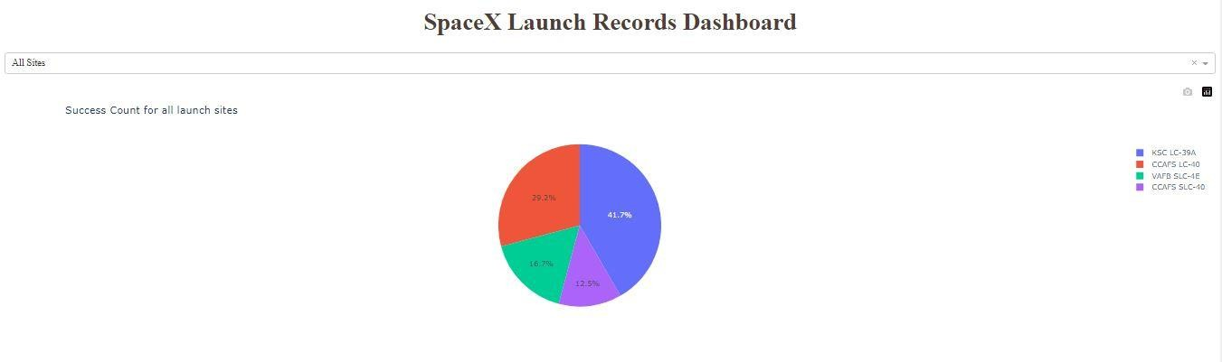
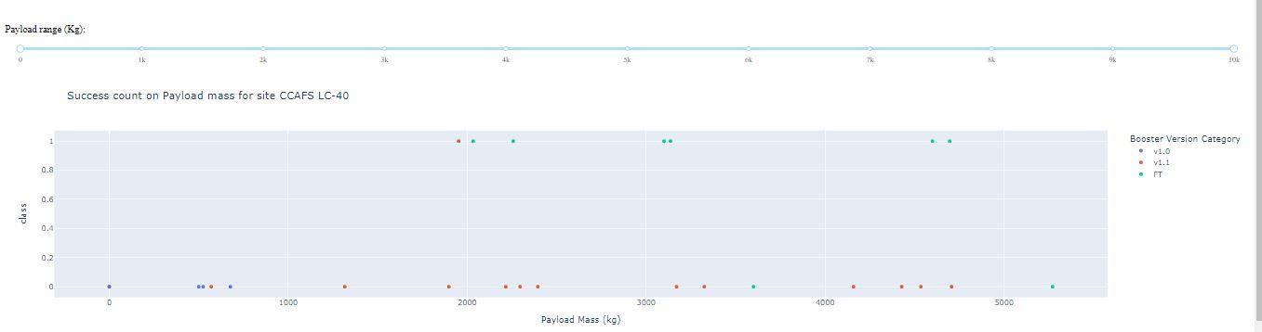
SpaceX Dash App

Slide 20
Predictive Analysis (Classification)
We loaded the data using numpy and pandas, transformed the data, split our data into training and testing.
We built different machine learning models and tune different hyperparameters using GridSearchCV.
We used accuracy as the metric for our model, improved the model using feature engineering and algorithm tuning.
We found the best performing classification model.
The link to the notebook is https://github.com/sadiqkhan/testrepo/blob/main/SpaceX_Machine%20Learning%20Prediction_Part_5.ipynb

Slide 21
Predictive Analysis (Classification)
The goal of this project was to develop a classification model to predict the success of SpaceX launches based on historical data. This report outlines the steps taken to build, evaluate, and improve the classification model, leading to the selection of the best-performing model.
The Gradient Boosting Classifier was selected as the final model due to its superior performance in classification tasks. The process involved thorough data preprocessing, model evaluation, and iterative improvements. The final model demonstrated robust performance, making it suitable for predicting the success of SpaceX launches based on historical data.
The link to the notebook is https://github.com/sadiqkhan/testrepo/blob/main/SpaceX_Machine%20Learning%20Prediction_Part_5.ipynb

Slide 22
Predictive Analysis (Classification)
Summary of how I built, evaluated, improved, and found the best performing classification model
After loading the data as a Pandas Dataframe, I set out to perform exploratory Data Analysis and determine Training Labels by;
creating a NumPy array from the column Class in data, by applying the method to_numpy() then assigned it to the variable Y as the outcome variable.
Then standardized the feature dataset (x) by transforming it using preprocessing.StandardScaler() function from Sklearn.
After which the data was split into training and testing sets using the function train_test_split from sklearn.model_selection with the test_size parameter set to 0.2 and random_state to 2.

Slide 23
Predictive Analysis (Classification)
In order to find the best ML model/ method that would performs best using the test data between SVM, Classification Trees, k nearest neighbors and Logistic Regression;
First created an object for each of the algorithms then created a GridSearchCV object and assigned them a set of parameters for each model.
For each of the models under evaluation, the GridsearchCV object was created with cv=10, then fit the training data into the GridSearch object for each to Find best Hyperparameter.
After fitting the training set, we output GridSearchCV object for each of the models, then displayed the best parameters using the data attribute best_params_ and the accuracy on the validation data using the data attribute best_score_.
Finally using the method score to calculate the accuracy on the test data for each
model and plotted a confussion matrix for each using the test and predicted outcomes.

Slide 24
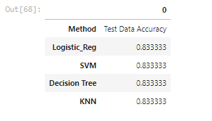
Predictive Analysis (Classification)
The table below shows the test data accuracy score for each of the methods comparing them to show which performed best using the test data between SVM, Classification Trees, k nearest neighbors and Logistic Regression;
GitHub URL of the completed predictive analysis lab (https://github.com/sadiqkhan/testrepo/blob/main/SpaceX_Machine%20Learning%20Prediction_Part_5.ipynb)
20

Slide 25
Results
Exploratory data analysis results
Interactive analytics demo in screenshots
Predictive analysis results

Slide 26

Section 2

Slide 27

Flight Number vs. Launch Site
From the plot, we found that the larger the flight amount at a launch site, the greater the success rate at a launch site.

Slide 28


Payload vs. Launch Site

Slide 29
Success Rate vs. Orbit Type
From the plot, we can see that ES-L1, GEO, HEO, SSO, VLEO had the most success rate.

Slide 30

Flight Number vs. Orbit Type
Here LEO orbit, success is related to the number of flights.

Slide 31

Payload vs. Orbit Type

Slide 32

Launch Success Yearly Trend
From the plot, we can observe that success rate since 2013 kept on increasing till 2020.

Slide 33

All Launch Site Names

Slide 34

Launch Site Names Begin with 'CCA'

Slide 35

Total Payload Mass

Slide 36

Average Payload Mass by F9 v1.1

Slide 37

First Successful Ground Landing Date

Slide 38

Successful Drone Ship Landing with Payload between 4000 and 6000

Slide 39

Total Number of Successful and Failure Mission Outcomes

Slide 40

Boosters Carried Maximum Payload

Slide 41

2015 Launch Records

Slide 42

Rank Landing Outcomes Between 2010-06-04 and 2017-03-20

Slide 43


Slide 44

All launch sites global map markers

Slide 45

Markers showing launch sites with color labels

Slide 46

Launch Site distance to landmarks

Slide 47


Slide 48

Pie chart showing the success percentage achieved by each launch site

Slide 49

Pie chart showing the Launch site with the highest launch success ratio

Slide 50
Pie-Chart for launch success count for all sites
Launch site KSC LC-39A has the highest launch success rate at 42% followed by CCAFS LC-40 at 29%, VAFB SLC-4E at 17% and lastly launch site CCAFS SLC-40 with a success rate of 13%
50

Slide 51
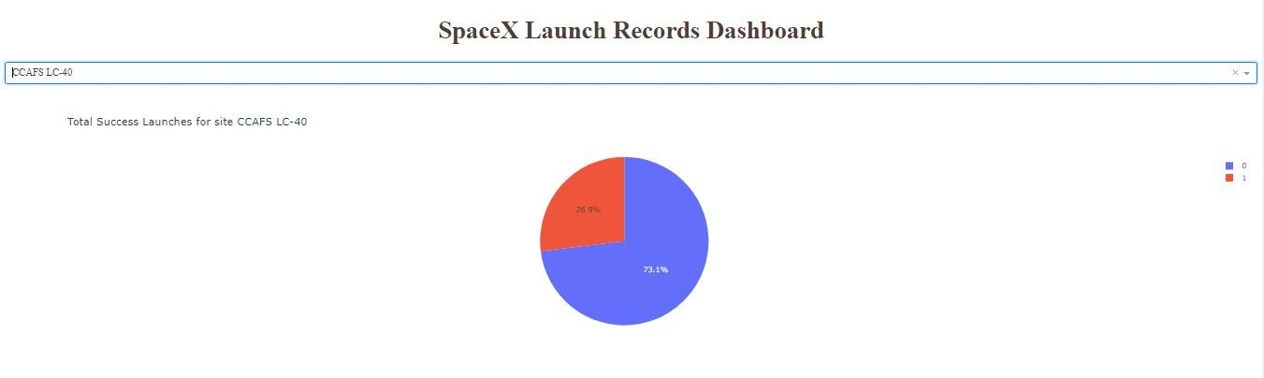
Pie chart for the launch site with 2nd highest launch success ratio
Launch site CCAFS LC-40 had the 2nd highest success ratio of 73% success against 27% failed launches
51

Slide 52
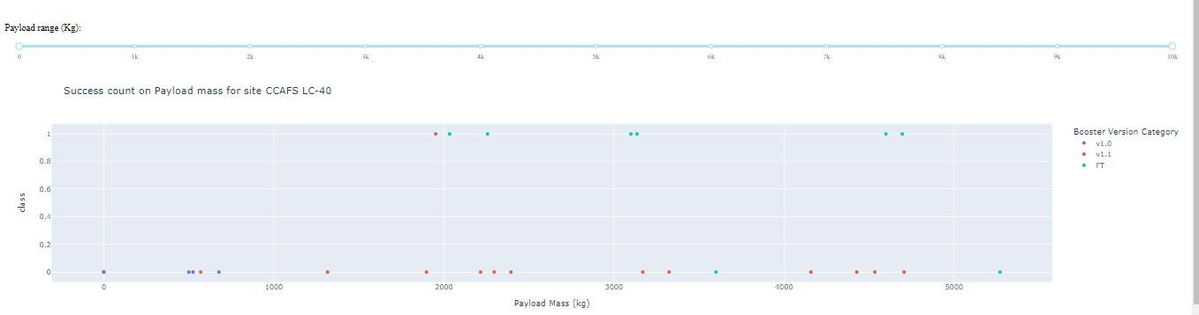
Payload vs. Launch Outcome scatter plot for all sites
For Launch site CCAFS LC-40 the booster version FT has the largest success rate from a payload mass of >2000kg
52

Slide 53

Scatter plot of Payload vs Launch Outcome for all sites, with different payload selected in the range slider

Slide 54


Slide 55

Classification Accuracy
The decision tree classifier is the model with the highest classification accuracy

Slide 56
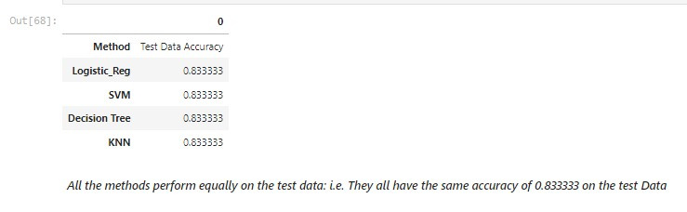
Classification Models Accuracy

Slide 57

Confusion Matrix
The confusion matrix for the decision tree classifier shows that the classifier can distinguish between the different classes. The major problem is the false positives .i.e., unsuccessful landing marked as successful landing by the classifier.

Slide 58
Conclusions
Different launch sites have different success rates. CCAFS LC-40, has a success rate of 60 %,
while KSC LC-39A and VAFB SLC 4E has a success rate of 77%.
We can deduce that, as the flight number increases in each of the 3 launcg sites, so does the success rate. For instance, the success rate for the VAFB SLC 4E launch site is 100% after the Flight number 50. Both KSC LC 39A and CCAFS SLC 40 have a 100% success rates after 80th flight
If you observe Payload Vs. Launch Site scatter point chart you will find for the VAFB-SLC
launchsite there are no rockets launched for heavypayload mass(greater than 10000).
Orbits ES-L1, GEO, HEO & SSO have the highest success rates at 100%, with SO orbit having the lowest success rate at ~50%. Orbit SO has 0% success rate.
LEO orbit the Success appears related to the number of flights; on the other hand, there seems
to be no relationship between flight number when in GTO orbit

Slide 59


